Slide 1
Module 4 Marketing Fundamentals & Brand Management
Jeff Lokey

Slide 2
COURSE OBJECTIVES
1: Identify the major components of the marketing mix.
2: Describe how segmentation and research foster an understanding of consumer behavior.
3: Describe the marketing concept.
4: Differentiate among the components of a marketing strategy.
5: Analyze consumer decision-making processes to predict buying behavior.
6: Identify the implications of marketing research on marketing strategy.
7: Describe elements of customer-relationship management, including the customer life cycle and the customer value proposition.
8: Identify the marketing implications of customer-relationship management.
9: Describe brand, product development, technology adoption cycle, and product life cycle.
10: Advise clients how to identify marketing needs for their business and utilize low cost and effective promotional and social media tools.

Slide 3
SMALL BUSINESS MARKETING 101
Get started: Brainstorm, create themes, develop an elevator pitch, plan a soft opening or invitation-only event
Get a Website: Mobile-friendly, search-engine optimization, Google analytics
Leverage social media: Create a Facebook page
Target the type of products or services you offer; Use Google AdWords
Create local awareness and establish a network: Join chambers, business associations, community groups; sponsor events; give away swag
Offer free products/services, customer discounts, and promotions; track customer response
Advertise
Aggressively solicit referrals: offer incentives, use email
Recontact old customers
Partner with complimentary businesses
Promote your expertise
Manage online ratings and review sites
From Forbes Magazine

Slide 4
1. THE MARKETING MIX - PRODUCT
Product design – features, quality
50 most iconic product designs:
https://www.complex.com/style/2013/02/the-50-most-iconic-designs-of-everyday-objects/jc-pennys-coffee-maker
VIDEO Lumio: https://www.youtube.com/watch?v=kwz1cfN6c0Q (1:47)
Product assortment – product range, product mix, product lines
Branding
Packaging and labeling
8 iconic packaging designs:
https://blog.hubspot.com/marketing/iconic-packaging-designs-stories
Services (complementary service, after-sales service, service level)
Guarantees and warranties
Returns
Managing products through the life-cycle

Slide 5
THE MARKETING MIX - PLACE
Strategies such as intensive distribution, selective distribution, exclusive distribution
Franchising
Market coverage
VIDEO Ikea Place: https://www.youtube.com/watch?v=UudV1VdFtuQ (1:00)
Channel member selection and channel member relationships
Assortment
Location decisions
VIDEO: Beacon Technology https://www.youtube.com/watch?v=ZGL0HpNm5BY (3:31)
Inventory
Transport, warehousing and logistics

Slide 6
THE MARKETING MIX - PRICE
Price strategy (Every Day Low Pricing, High/Low, Penetration Pricing, Price Skimming)
Price tactics (Markdowns, Seasonal Discounts, Coupons, Rebates, Leasing, Bundling, Leader)
Price-setting (Cost-Based, Competition-Based, Value-Based)
Payment terms – (credit, payment methods)

Slide 7
THE MARKETING MIX - PROMOTION
Promotional mix - appropriate balance of advertising, PR, direct marketing and sales promotion
Message strategy - what is to be communicated
Channel/ media strategy - how to reach the target audience
Message Frequency - how often to communicate
Worst Promotions in History: https://www.4allpromos.com/blog/2018/04/ten-worst-corporate-promotional-events-all-time-0

Slide 8
4 P’s Exercise
1 – Create a simple two-column table with 8 rows in each.
2 – Label the left column “Low-cost Frequent Purchase” and the right column “High-cost One-Time Purchase”
3 – Label the rows, from top to bottom: Brand, Product, Price, Promotion, Place, #1 Reason I Bought, Alternate Brand, #1 Reason I Didn’t Buy
4 – Complete the chart as follows, starting with the left column:
Choose a low-cost item that you buy regularly (Coffee, toothpaste, razor blades, etc)
List the Brand, Product, and Price you paid in the first three boxes
List the most recent Promotional piece for that product you saw (commercial, ad, website, etc), and whether you believe it influenced your choice
List the Place you made your purchase (Walmart, Starbucks, Online, etc)
List the #1 Reason you bought that particular product (price, quality, taste, etc)
List a competing brand that would be your #1 choice as an alternate if you couldn’t buy your preferred item
List the #1 reason you did not choose that brand
5 – Repeat those actions for the right column, but with an expensive product you don’t buy often. (Car, Vacation, TV, computer, etc)

Slide 9
2. SEGMENTING, TARGETING & POSITIONING

Slide 10
SEGMENTATION
Market Segments Should Be Identifiable, Substantial, Reachable, Responsive, & Profitable
VIDEO: https://www.youtube.com/watch?v=nU_oV0N414A (2:52)
Demographic Segmentation (age, gender, race, income, religion, occupation, etc.)
Geographic Segmentation
Benefit Segmentation
Behavioral Segmentation – buying patterns of customers (usage frequency, timing, journey stage, brand loyalty, benefits needed, etc.)
Psychographic Segmentation - http://www.strategicbusinessinsights.com/vals/ustypes.shtml
http://www.strategicbusinessinsights.com/vals/demobehav.shtml
Psychographics; The behavioral analysis that helped Cambridge Analytics know voter’s minds:
http://theconversation.com/psychographics-the-behavioural-analysis-that-helped-cambridge-analytica-know-voters-minds-93675

Slide 11
MARKET SEGMENTATION RESEARCH
Conduct Preliminary Research – Get to know your customers better by asking some initial, open-ended questions.
Determine How To Segment Your Market – Decide which criteria (i.e. demographics/firmographics, psychographics, or behavior) you want to segment your market by.
Design Your Study – Ask a mix of demographic/firmographic, psychographic, and behavioral questions. Be sure to make your questions quantifiable.
Create Your Customer Segments – Analyze your responses either manually or with statistical software to create your segments.
Test and Iterate – Evaluate your segments by ensuring they are usable and helpful. If they aren’t, try segmenting based on other criteria.
A good segmentation analysis should pass the following tests:
Measurable
Accessible
Substantial
Actionable
From Qualtrics.XM

Slide 12
3. THE MARKETING CONCEPT
The Production Concept
Can we produce the product?
Can we produce enough of it?
The Sales Concept
Can we sell the product?
Can we charge enough for it?
VIDEO: Mad Men “Lucky Strikes Cigarettes Pitch”: https://vimeo.com/123757690 (5:50)
The Marketing Concept
What do customers want?
Can we develop it?
How can we keep our customers satisfied?
VIDEO: Mad Men “Belle Jolie Lipstick Pitch” https://www.youtube.com/watch?v=5y4b-DEkIps (2:06)

Slide 13
4. TARGET MARKETING
Mass Marketing Strategy (Undifferentiated)
Example – Commodities, Coca-Cola
Advantages – Massive sales, scale efficiencies
Disadvantages – Overexposure, increased competition, geographical differences, less personal
Differentiated Targeting Strategy (Two or more segments)
Example - Conde Nast niche magazines (Glamour, Golf Digest, SELF, bon appetite, VOGUE, Vanity Fair, The New Yorker, Teen Vogue, GQ Gentleman’s Quarterly, Pitchfork)
Advantages – Cost efficient, chance for organic growth, sales maximization, strong margins, brand loyalty
Disadvantages – Expensive to develop unique products, messages, campaigns promotional tactics and investments

Slide 14
TARGET MARKETING
Concentrated Targeting Strategy (focus on a single niche market)
Advantages – good for small businesses with limited resources, potential for high profits,
Disadvantages – Dependent on small market, requires specialized marketing plan, lacks flexibility
Micromarketing Strategy (one-to-one)
Example – Groupon
Advantages – Highly targeted, cost effective, user-generated growth
Disadvantages – High acquisition cost, misjudging market, time-consuming

Slide 15
POSITIONING
Value Proposition:
LYFT – “Rides in Minutes”; Vimeo – “Make Life Worth Watching”; Pinterest – “The World’s Catalog of Ideas”.
Product Attributes/Benefits
Price/Quality
Use or Application
Product Class
Cultural Symbols
Competition

Slide 16
MARKET SEGMENTATION EXERCISE
Match at least one product and/or service that you have purchased this year that corresponds to one segment of the following groupings:
Demographic Segmentation (age, gender, race, income, religion, occupation, etc.)
Geographic Segmentation
Benefit Segmentation
Behavioral Segmentation – buying patterns of customers (usage frequency, timing, journey stage, brand loyalty, benefits needed, etc.)
Psychographic Segmentation

Slide 17
BUSINESS TO BUSINESS (B2B) MARKETING
Six Buying Roles:
The Initiator
The Influencer
The Decider
The Buyer
The User
The Gatekeeper
The Buying Situation:
The New Buy
The Modified Rebuy
The Straight Rebuy
Firmographic Segmentation:
Industry
Location
Company Size (annual revenue, number of employees)
Legal Status (LLC, limited partnership, etc.)
Performance
Executive Title
Sales Cycles Stage (awareness, consideration, decision)

Slide 18
BUSINESS TO BUSINESS (B2B) MARKETING
How B2B marketing is different from consumer marketing:
B2B markets have a more complex decision-making unit
B2B buyers are more rational and longer-term buyers.
Limited number of buying units in B2B markets.
B2B markets have fewer behavioral and needs-based segments.
Personal relationships are more important in B2B markets.
B2B markets drive innovation less than consumer markets, are more demanding, and often more complex.
Consumer markets rely more on packaging.
Taken from B2B International website: https://www.b2binternational.com/publications/b2b-marketing/

Slide 19
WHY WE BUY: RETAIL
Good Performance Indicators:
Conversion rate – percentage of shoppers who become buyers
Time spent rate
Interception rate - transition zones
Waiting time - single most important factor in consumer satisfaction
Capture rate - how much in what is on display is seen by shoppers (eyes to knees, endcaps, chevroning)
Boomerang rate - number of shoppers who fail to walk completely through an aisle (position most popular goods halfway down the aisle)
What Shoppers Love:
Touch - involvement
Mirrors - the more the better
Discovery
Talking
Recognition
Bargains - Ikea
From Why We Buy by Paco Underhill

Slide 20
WHY WE BUY: RETAIL
Women:
Take pleasure in shopping; demand more of shopping environment
Like to shop with friends
Want more space around them as they shop
Time spent in store from highest to lowest: with female companion, with children, alone, with a man
Men:
Do not enjoy shopping
Move faster than women through a store
Don’t like to ask staff for help; get info about merchandise from written sources.
From Why We Buy by Paco Underhill
Race, Ethnicity and the Way We Shop:
https://adage.com/article/american-demographics/race-ethnicity-shop/44089

Slide 21
6. MARKET RESEARCH
TYPES of DATA:
Secondary Data: Public information collected by others.
External Secondary Data (U.S. Bureau of the Census http://www.census.gov ; U.S. Bureau of Labor Statistics https://www.bls.gov/)
Syndicated External Data (e.g. scanner data)
Internal Secondary Data (Google Analytics: https://analytics.google.com/analytics/academy/course/6/unit/1/lesson/2 )
Primary Data: Data observed or collected directly from first-hand experience.
Observation
Social Media (Facebook, Twitter, Instagram, WhatsApp)
Interviews VIDEO: Mad Men https://www.youtube.com/watch?v=IWPuZodOQP0 (1:26)
Focus Groups VIDEO: Frazier https://www.youtube.com/watch?v=UInbPO1Shus (2:50)
Sample Small Business Marketing Plan:
https://www.sba.gov/sites/default/files/2017-07/Sample%20Marketing%20Plan%20%28for%20508%20remediation%29.pdf

Slide 22
MARKET RESEARCH
USES of MARKET RESEARCH:
Identify opportunities to serve various groups of customers.
Examine the size of the market – how many people have the unmet need.
Determine the best methods to meet the unmet needs of the target markets.
Investigate the competition.
Clarify your unique value proposition.
Conclude if the product is effectively meeting the needs of the customers.
Conclude if your advertising and promotions strategies are effective or not.

Slide 23
BIG DATA FOR SMALL BUSINESS
Facebook Marketing in 2020: How To Use Facebook for Business
https://blog.hootsuite.com/facebook-marketing-tips/#setup
Basic Introduction to using Google Analytics for Small Business Owners
https://www.youtube.com/watch?v=qPFQHgXajHQ (4:56)
What is Google Ads? How Google AdWords in Five Minutes
https://www.youtube.com/watch?v=NV4DCdyLNgU
What is a POS and Why Does Your Business Need One?
https://www.sba.gov/blog/what-pos-why-does-your-business-need-one
Email marketing
https://www.constantcontact.com/features/email-tracking-software

Slide 24
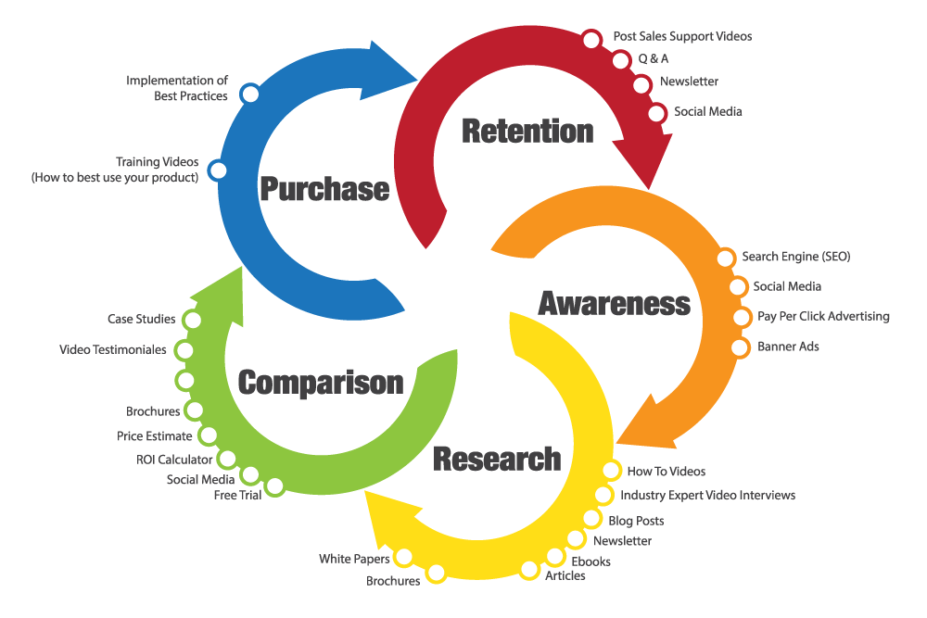
7. CUSTOMER LIFE CYCLE & CUSTOMER LIFETIME VALUE
Awareness
Research
Comparison
Purchase
Retention
The Customer Lifetime Value (CLV) is a prediction of the total value (mostly expressed in net profit) generated by a customer in the future across the entire customer life cycle. The value of the customer lifetime looks at the investments we plan to make for the customers (retention, sales, promotion, customer service, whatever) and the return we expect from them.
How To Calculate CLV: https://www.thebalancesmb.com/how-to-calculate-the-lifetime-value-of-a-customer-4173824

Slide 25
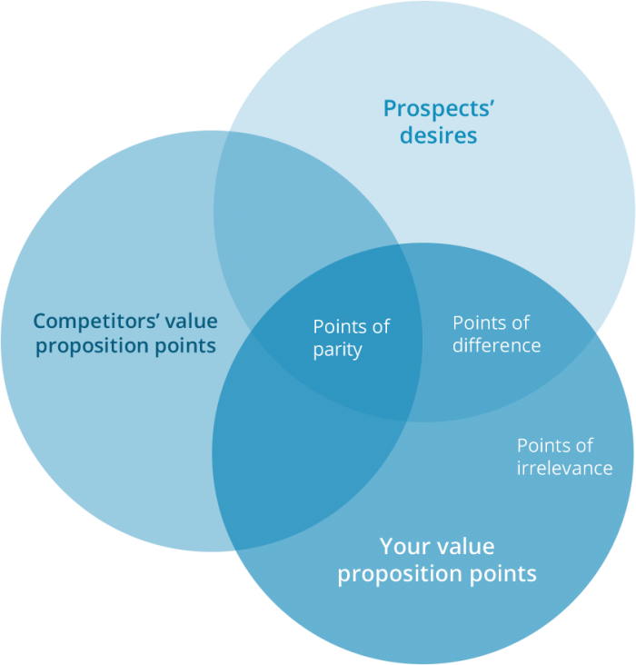
CUSTOMER VALUE PROPOSITION
A value proposition is a promise of value to be delivered. It’s the primary reason a prospect should buy from you.
Relevant
Specific
Differentiated
The 31 Best Value Proposition Examples You Wish You Had: https://www.impactbnd.com/blog/value-proposition-examples

Slide 26
8. CUSTOMER RELATIONSHIP MANAGEMENT
For small businesses, customer relationship management includes:
Processes that help identify and target their best customers, generate quality sales leads and plan and implement marketing campaigns with clear goals and objectives
Processes that help form individualized relationships with customers (to improve customer satisfaction) and provide the highest level of customer service to the most profitable customers
Processes that provide employees with the information they need to know their customers' wants and needs and build relationships between the company and its customers.
The Benefits of CRM include:
Customer relationship management gathers comprehensive data about customers, their needs and preferences, which can then be used to:
Improve customer service and the customer's buying journey
Drive product development
Personalize advertising
Find new customers
Increase sales
From thebalancecareers.com

Slide 27
CUSTOMER RELATIONSHIP MANAGEMENT
What Kinds of Data Are Recorded by a CRM System?
Contact Details
Customer Personal Profile
Sales History
Customer Communication
Customer Feedback
Free CRM Systems:
HubSpot CRM
Freshsales
Zoho CRM
Really Simple Systems
Workbooks.com
Insightly
Apptivo
Capsule CRM
Zoho ContactManager
RAYNET CRM
Agile CRM

Slide 28
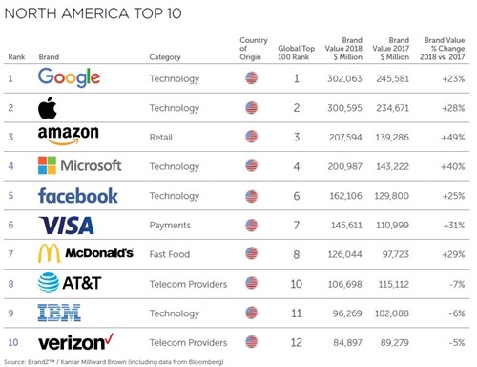
9. THE POWER OF BRANDS
ADDING VALUE:
Brands Facilitate Purchases
Brands Establish Loyalty
Brands Protect from Competition
Brands Are Assets
Brands Affect Market Value
BRAND EQUITY:
Brand Awareness
Perceived Value
Brand Associations
Brand Loyalty
5 Inexpensive Branding Strategies
For Small Businesses
https://99designs.com/blog/business/cheap-branding-strategies-small-business/
From 99designs

Slide 29
NEW PRODUCT DEVELOPMENT
Idea Generation (R & D, Licensing, Brainstorming, Outsourcing, Rival Products, Customer Input)
Concept Testing (Concept Statement)
Product Development (Prototypes)
Market Testing
Product Launch
Evaluation of Product
VIDEO: Shark Tank Products:
https://www.youtube.com/watch?v=vi6tbfp14-A (1:06)

Slide 30
TECHNOLOGY ADOPTION CYCLE
DIFFUSION OF INNOVATION:
Innovators – 2.5%
Early Adopters – 13.5%
Early Majority – 34%
Late Majority – 34%
Laggards – 16%
PACE OF INNOVATION:
Relative Advantage
Compatibility
Observability
Complexity and Trialability

Slide 31
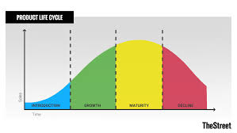
PRODUCT LIFE CYCLE
Product Life Cycle
Introduction Stage
Growth Stage
Maturity Stage
Decline Stage
Introduction
Growth
Maturity
Decline

Slide 32
10. SOCIAL MEDIA MARKETING
Why Small Businesses Need Social Media:
Your customers are on social media (60% of people access social media every day)
Consumers will be more receptive to brand messages on social media (95% of adults age 18-34 follow a brand on social network)
Marketing on social media increases brand recognition and your inbound traffic.
Different social media channels help you reach specific audiences.
Social media advertising allows you to target and retarget ideal customers.
Marketing through social media is cost effective. (Cost per thousand impressions can be as low as $2.50
From Lyfe Marketing

Slide 33
SOCIAL MEDIA MARKETING
Why Small Businesses Need Social Media:
Your competition is on social media.
Social media marketing may help improve your search rankings and gives you the opportunity to gain new customer insights.
Customers are looking for recommendations on social media.
Social media helps connect your brand with customers you didn’t know existed.
Marketing through social media can help you improve brand loyalty and leads to higher conversion rates.
From Lyfe Marketing

Slide 34
SMALL BUSINESSES WHO SUCCESSFULLY USE SOCIAL MEDIA …
1. Commit weekly resources to creating content and engaging in social media.
2. Have some methods of understanding how social media activity had an impact on business results.
3. Regularly generate content using blogs, Twitter, Facebook or other social platforms.
4. Don’t try to do use every platform, instead focusing time and resources on the social media channels that drive the best results for their business.
5. Use social media to drive participation in offline events. 6. Set clear expectations for customers regarding frequency and
types of social media interactions their company is willing to
provide. 7. Provide clear calls-to-action and opportunities to generate leads
and new customers using social media. 8. Use information and data from social media to drive business
strategy. 9. Balance paid and organic search engine traffic.
From HubSpot

Slide 35
SOCIAL MEDIA MARKETING
Best Social Media Platforms:
https://www.lyfemarketing.com/blog/wp-content/uploads/2018/02/The-Best-Social-Media-Platforms-for-Social-Media-Marketing-in-2018.pdf
Findings from 2019 Social Media Marketing Industry Report:
https://medium.com/@JBBC/10-key-findings-from-the-2019-social-media-marketing-industry-report-9ffb95b33926
6 Standout Social Media Marketing Examples for 2019:
https://sproutsocial.com/insights/social-media-marketing-examples/
The State of Small Business Marketing in 2019:
https://www.campaignmonitor.com/resources/guides/the-state-of-small-business-marketing/

Slide 36
ETHICS IN MARKETING
American Marketing Association Ethical Norms:
As Marketers, we must:
1. Do no harm. This means consciously avoiding harmful actions or omissions by embodying high ethical standards and adhering to all applicable laws and regulations in the choices we make.
2. Foster trust in the marketing system. This means striving for good faith and fair dealing so as to contribute toward the efficacy of the exchange process as well as avoiding deception in product design, pricing, communication, and delivery of distribution.
3. Embrace ethical values. This means building relationships and enhancing consumer confidence in the integrity of marketing by affirming these core values: honesty, responsibility, fairness, respect, transparency and citizenship.

Slide 37
ETHICS IN MARKETING
America Marketing Association Ethical Values:
Honesty – to be forthright in dealings with customers and stakeholders.
Responsibility – to accept the consequences of our marketing decisions and strategies.
Fairness – to balance justly the needs of the buyer with the interests of the seller.
Respect – to acknowledge the basic human dignity of all stakeholders.
Transparency – to create a spirit of openness in marketing operations.
Citizenship – to fulfill the economic, legal, philanthropic and societal responsibilities that serve stakeholders.

Slide 38
UNETHICAL MARKETING TACTICS
Misleading statements, which can land a business in legal trouble with the Federal Trade Commission and its truth in advertising provision. The FTC expects advertising claims to be supported by evidence, Of course, not all claims are provable, and this is where some marketers deliberately try to blur the line with exaggerated claims and puffery, which are other forms of unethical marketing.
Distorting facts to intentionally confuse or mislead consumers. A classic example: stamping a product as sugar- or calorie-free when it does in fact contain some sugar and calories, or touting a product as “healthy” when it is loaded with carbohydrates and sodium.
Making false or deceptive comparisons about a rival product. Competition tends to be fierce when rivals resort to side-by-side comparisons. And consumers may find such a technique helpful, as long as the information is accurate and truthful.
Inciting fear or applying unnecessary pressure. “Limited time offers” are notorious for the latter, which is fine if a deadline really exists and the tone doesn't sound threatening.
Exploiting emotions or a news event. Such instances pop up every once in a while, then make a quick exit when consumers complain about feeling manipulated. Such was the case after the September 11 terrorist attacks, when some advertisers tried to evoke sympathy – for New Yorkers, firefighters and survivors – while also selling their products.

Slide 39
UNETHICAL MARKETING TACTICS
Stereotyping or depicting women as sex symbols merely to draw attention to a product. "While it might be intuitive to use models in adverts for beauty products and cosmetics, having half-naked models in adverts for generators, heavy machinery, smartphones and other products not strongly related to women is both nonsensical and unethical,” says Profitable Venture.
Disparaging references to age, gender, race or religion. Many professional comics have learned the hard way that the line between humor and bad taste can be painfully thin. It might be easier to see if the humor packs an insult or a put-down that makes you grimace.
Doctoring photos or using photos that are not authentic representations. Most people expect professional photographers and videographers to make the most of lighting and close-ups. But the finished products should be accurate depictions that are free of touch-ups and other enhancement techniques that are designed to mislead.
Plagiarizing a competitor. For a small-business owner, discovering that a competitor has copied or impinged on a tagline, blog post or promotion can be painful –or infuriating. The reality is, plagiarism probably happens more often than most businesspeople will ever know, because of the internet.
Spamming, or sending unsolicited emails to potential customers. The FTC allows a business one such opportunity. After that, a business violates the CAN-SPAM act. In effect since 1993, the act also prohibits false or misleading header information and deceptive subject lines.

Slide 40
CLASS DISCUSSION: MARKETING AND PANDEMICS
What unethical marketing practices would you predict being used during the coronavirus pandemic? Consider how the marketing concepts we have discussed today might be used against a vulnerable public during this crisis.

Slide 41
MARKETING IN BOSTON
The Boston Red Sox Marketing Campaign
https://www.ctpboston.com/work/boston-red-sox/season-campaign/
HubSpot (Cambridge, MA)
Inbound Marketing https://www.hubspot.com/
MBTA Customer Opinion Panel
https://www.mbta.com/customer-opinion-panel

Slide 42
RESOURCES
1. Marketing Plan Guide (SCORE)
https://www.score.org/resource/marketing-plan-guide
2. Annual Marketing Budget Template (SCORE)
https://www.score.org/resource/annual-marketing-budget-template
3. Google for Small Business
https://smallbusiness.withgoogle.com/
4. Resources for Minority-Owned Businesses
https://www.fundingcircle.com/us/resources/minority-owned-businesses/

